Slide 1
Probability

Slide 2
Probability
Probability is a measure of likelihood that an event will occur.
Example: Tossing a coin: When a coin is tossed, there are two possible outcomes : either heads (H) or tails (T). We say that the probability of the coin landing H is ½. And the probability of the coin landing T is ½

Slide 3
TERMINOLOGY
Random Experiment: Experiments whose outcomes are unpredictable is known as Random Experiments. For example: Tossing a coin
Sample Space(S): It is the collection of all possible outcome of an experiment. Example: In tossing a coin one time S={H,T}

Slide 4
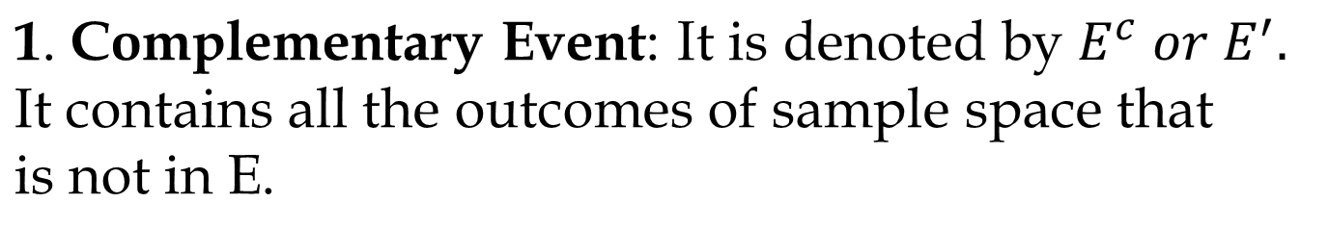
Event: The outcome of an experiment is known as Event. Mathematically we can say that event is a subset of sample space.
Example: Getting a head while tossing a coin one time is an event.
Types of Events:
For example If S={1,2,3,4,5,6} and E=[odd no.]={1,3,5}
Then E'=[Even number]={2,4,6}

Slide 5
2. Equally likely Events: If E and F are two events such that P(E)= P(F) then these are called Equally Likely events. For e.g. In Tossing a coin probability of coming up of head and tail is Equal.
3. Mutually Exclusive Event: Two or more events are said to be mutually exclusive if both cannot occur simultaneously in the same experiment.
Example: In a throw of single coin, either head can come or tail can come. There will be no common outcome in those events. It means E∩F=Φ (null Set)

Slide 6
4. Collective Exhaustive Events: If E and F are two events and both events gives complete sample space then these are called Exhaustive events.
E U F = S
5. Independent Events: Two events are said to be independent of each other when the happening of one event does not affect the happening of other event and vice versa. Here sample spaces are different for both cases.
When two events A and B are independent, the probability of both occurring is:
P(A and B)= P(A). P(B)

Slide 7
Probability: The probability of an event is defined as the ratio of no. of ways an event can happen to the no. of ways sample space can happen.
Let S be the sample space and let E be the event.
PROBABILITY= n(E)/n(S)
6. Dependent Events: Two events are dependent if the outcome or occurrence of the first affects the outcome or occurrence of the second so that the probability is changed.

Slide 8
When two events, A and B, are dependent, the probability of both occurring is:
P(A and B) = P(A) · P(B|A)
where P(B|A) is the conditional probability of an event B in relationship to an event A is the Probability that event B occurs given that event A has already occurred.
Example: The probability of choosing a jack on the second pick given that a queen was chosen on the first pick (without replacement) is called a conditional probability.

Slide 9
Rules of Probability
0 <P (E) <1
2. P(S) = 1 (Definite event)
3. P(Φ) = 0 (Impossible event)
4. If A’ denotes (not-A), then P(A’) = 1 - P(A).
5. For any events A and B we have :
P(AUB) = P(A) + P(B) - P(A∩B)
But for mutually exclusive event P(A∩B)=0
For mutually exclusive events
P(AUB) = P(A) + P(B)

Slide 10
6. P(A∩B)= P(A). P(B/A) = P(B). P(A/B)
7. P(AUBUC)=P(A)+P(B)+P(C)-P(A∩B)-P(B∩C)
-P(C∩A)+P(A∩B∩C)

Slide 11
Coins
One coin {H,T}= 2
Two coins={HH,HT,TH,TT}= 4
Three Coin={HHH,TTT,HHT,TTH,HTH,THT,THH,HTT}= 8
Four Coins={HHHH, TTTT
HHHT, TTTH
HHTH, TTHT
HTHH, THTT
THHH, HTTT,
HHTT, HTTT,
HTTH, HTHT
TTHH, THTH} =16

Slide 12
Question 1: In a simultaneous toss of 2 coins find the probability of 2 Tails?
[A] 1/2
[B] 1/4
[C] 2/3
[D] 3/4

Slide 13
Question 2: In a simultaneous toss of 2 coins find the probability of Exactly 1 Tail?
[A] 1/3
[B] 2/3
[C] 3/4
[D] 1/2

Slide 14
Question 3: In a simultaneous toss of 2 coins find the probability of No Tail?
[A] 1/3
[B] 1/4
[C] 1/2
[D] 2/3

Slide 15
Question 4: In a simultaneous toss of 2 coins find the probability of No head?
[A] 1/2
[B] 1/4
[C] 1/3
[D] 2/3

Slide 16
Question 5: Three coins are tossed simultaneously. Find the probability of all are heads.
[A] 1/4
[B] 1/8
[C] 2/3
[D] 5/8

Slide 17
Question 6: Three coins are tossed simultaneously. Find the probability of exactly two heads.
[A] 1/4
[B] 1/8
[C] 3/8
[D] 5/8

Slide 18
Question 7: Three coins are tossed simultaneously. Find the probability of at least two heads.
[A] 1/3
[B] 1/8
[C] 1/8
[D] 3/8

Slide 19
Question 8: Three coins are tossed simultaneously. Find the probability of no heads.
[A] 1/8
[B] 1/4
[C] 1/2
[D] 5/8

Slide 20
Question 9: Three coins are tossed simultaneously. Find the probability of at least 1 head and 1 tail.
[A] 1/8
[B] 1/4
[C] 3/4
[D] 5/8

Slide 21
Question 10: 4 coins are tossed simultaneously. Find the probability exactly 3 tails
[A] 1/8
[B] 1/4
[C] 1/2
[D] 5/8

Slide 22
Question 11: 4 coins are tossed simultaneously. Find the probability at least 1 tail.
[A] 1/16
[B] 1/4
[C] 1/2
[D] 15/16

Slide 23
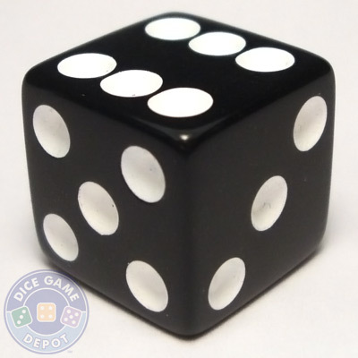
DICE
When a dice is thrown= {1, 2 , 3, 4, 5, 6} =6
When two dice are thrown, S = {(1,1),(1,2),(1,3),(1,4),(1,5),(1,6)
(2,1),(2,2),(2,3),(2,4),(2,5),(2,6)
(3,1),(3,2),(3,3),(3,4),(3,5),(3,6)
(4,1),(4,2),(4,3),(4,4),(4,5),(4,6)
(5,1),(5,2),(5,3),(5,4),(5,5),(5,6)
(6,1),(6,2),(6,3),(6,4),(6,5),(6,6)} = 36

Slide 24
Question 1: In a single throw of 2 Dice, What is the probability of a doublet?
[A] 1/3
[B] 1/36
[C] 1/6
[D] 1/12

Slide 25
Question 2: In a single throw of 2 Dice, What is the probability of getting sum equals to:
5
Multiple of 5
7
Multiple of 3
Greater than 9

Slide 26
Short Cut For Two Dice
SUM | 2 | 3 | 4 | 5 | 6 | 7 | 8 | 9 | 10 | 11 | 12
Fav. | 1 | 2 | 3 | 4 | 5 | 6 | 5 | 4 | 3 | 2 | 1

Slide 27
Question 3: In a simultaneous throw of 3 Dice find the probability of getting a total of 5.
[A] 1/6
[B] 1/36
[C] 1/216
[D] 5/216

Slide 28

Cards
1. There are four Suits in a deck of Card viz. Spade, Diamond, Heart, Club.
2. Red card=26 (13 Diamonds+ 13 Hearts)
3. 3. Black Card= 26 (13 Clubs+13 Spades)
4. Every suit contains 13 cards viz. Ace, 2 to 10, Jack, Queen, King

Slide 29
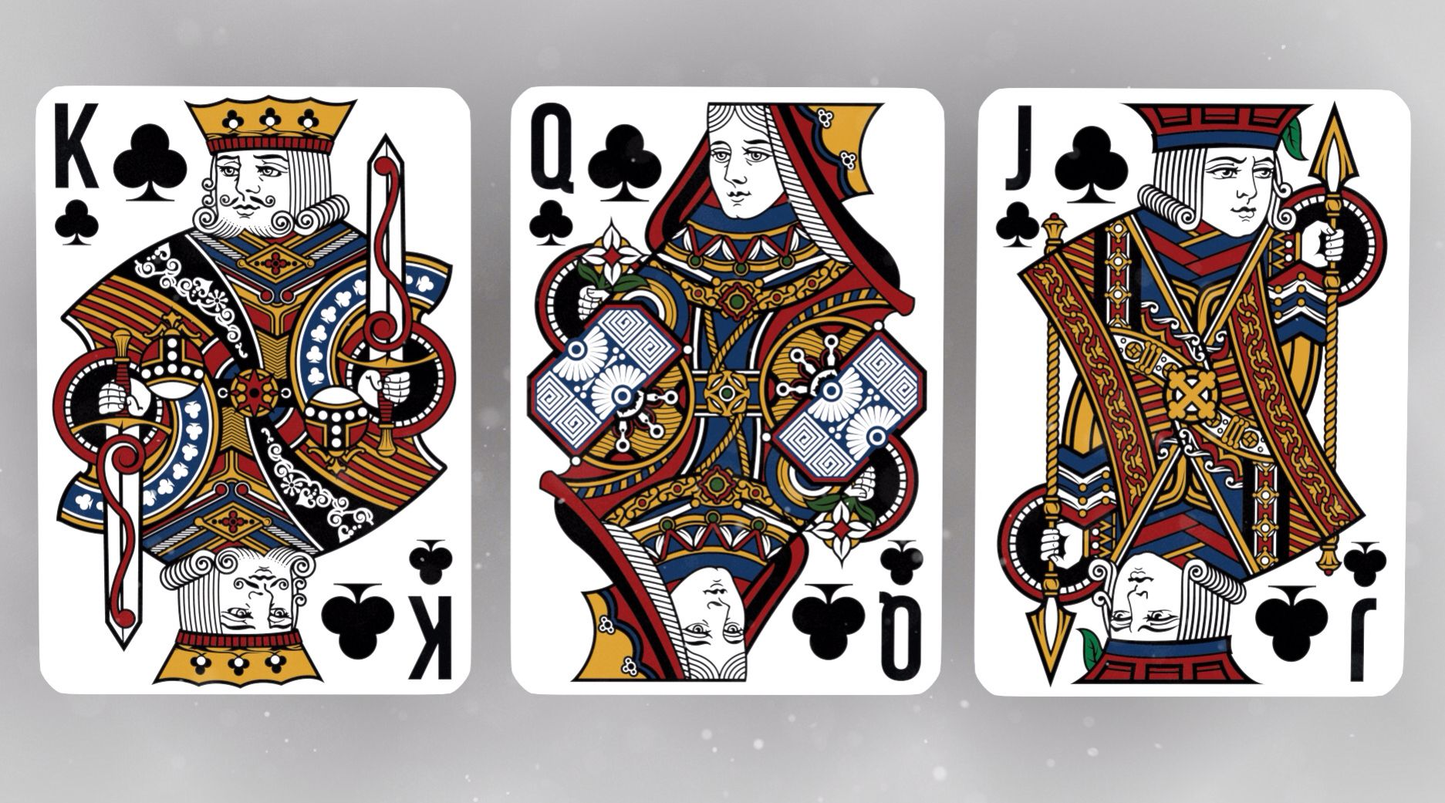
Face cards and Honored Card
Note: When ace is included in Face cards the combination is called Honored card.

Slide 30
Question 1: One card is drawn at random from the well shuffled pack of 52 cards. What is the probability of picking a black card?
[A] 1/3
[B] 1/2
[C] 1/4
[D] 1/13

Slide 31
Question 2: One card is drawn at random from the well shuffled pack of 52 cards. What is the probability of picking a Ace of spades or the jack of diamonds?
[A] 1/52
[B] 1/26
[C] 1/13
[D] 1/4

Slide 32
Question 3: One card is drawn at random from the well shuffled pack of 52 cards. What is the probability of picking an ace?
[A] 1/13
[B] 1/52
[C] 1/26
[D] 1/4

Slide 33
Question 4: One card is drawn at random from the well shuffled pack of 52 cards. What is the probability that the card is either a red card or a King?
[A] 5/13
[B] 7/13
[C] 9/13
[D] 1/52

Slide 34
Question 5: One card is drawn at random from the well shuffled pack of 52 cards. What is the probability that it is neither club nor queen?
[A] 4/13
[B] 5/13
[C] 7/13
[D] 9/13

Slide 35
Balls in a Bag OR marbles in a Bag
Questions 1: .A bag contains 5 red balls and 7 blue balls. Two balls are drawn at random without replacement, and then find the probability of that one is red and other is blue.
[A] 33/65
[B] 35/66
[C] 37/66
[D] 41/65

Slide 36
Questions 2: . A urn contains 4 red balls, 5 green balls and 6 white balls, if one ball is drawn at random, find the probability that it is neither red nor white.
[A] 1/3
[B] 1/4
[C] 1/5
[D] 2/3

Slide 37
Questions 3: . A bag contains 6 red balls and 7 white balls. Another bag contains 5 red balls and 3 white balls. One ball is selected from each. Find the probability that one ball is red and one is white?
[A] 53/104
[B] 47/104
[C] 63/104
[D] 51/104

Slide 38
Questions 4: In a bag there are 4 white, 4 red and 2 green balls. Two balls are drawn at random. What is the probability that at least one ball is of red color?
[A] 4/3
[B] 7/3
[C] 1/3
[D] 2/3

Slide 39
Questions 5: . A bag contains 2 red caps, 4 blue caps, 3 yellow caps and 5 green caps. If three caps are picked at random, what is the probability that none is green?
[A] 2/13
[B] 3/13
[C] 1/13
[D] 5/13

Slide 40
Questions 6: A bag contains 5 red and 7 white balls. Four balls are drawn out one by one and not replaced. What is the probability that they are alternatively of different colors?
[A] 7/99
[B] 11/99
[C] 14/99
[D] 19/99

Slide 41
Questions 7: A basket contains 5 red 4 blue 3 green marbles. If three marbles picked up random, What is the probability that either all are green or all are red?
[A] 1/20
[B] 7/20
[C] 3/20
[D] 9/20

Slide 42
Questions 8: A bag contains 3 red balls and 8 blacks ball and another bag contains 5 red balls and 7 blacks balls, one ball is drawn at random from either of the bag, find the probability that the ball is red.
[A] 93/264
[B] 95/264
[C] 91/264
[D] 97/264

Slide 43
Miscellaneous Questions:
Questions 1: A fair dice is rolled twice. The probability that an odd number will follow on even number is? GATE-2005
[A] 1/2
[B] 1/6
[C] 1/3
[D] 1/4

Slide 44
Questions 2: An examination consists of two papers, Paper1 and 2. The probability of failing in Paper1 is 0.3 and that in paper 2 is 0.2. Given that a student has failed in paper2, the probability of failing in paper 1 is 0.6. the probability of failing in both the papers is? GATE-2007
[A] 0.5
[B] 0.18
[C] 0.12
[D] 0.06

Slide 45

Bayes' Theorem:
Let S be the sample space and let E1,E2,E3,……En be n mutually exclusive and exhaustive events associated with a random experiment. If A is any event which occurs with E1 or E2 or E3…or En. then,

Slide 46
Question : A card from a pack of 52 cards is lost. From the remaining cards of the pack, two cards are drawn and are found to be both hearts. Find the probability of the lost card being a heart?
[A] 12/50
[B] 8/50
[C] 11/50
[D] 9/50

Slide 47

Binomial Distribution:
If p is the probability of success of any event and q is the probability of failure of that event, then probability of event success x times in n trials( i.e. x success and n-x failure) is given by:
Where X= Random variable, x= no. of success in n trials
P= probability of success, q= 1-p= probability of failure

Slide 48
Question: Find the probability of getting sum 9 exactly two in three times with a pair of dice.
Answer= 8/243

Slide 49


